Slide 1

SYSTEM ANALYSIS PROJECT.
COFFE SHOP
9.24.XX

Slide 2
USECASE DIAGRAM

Slide 3
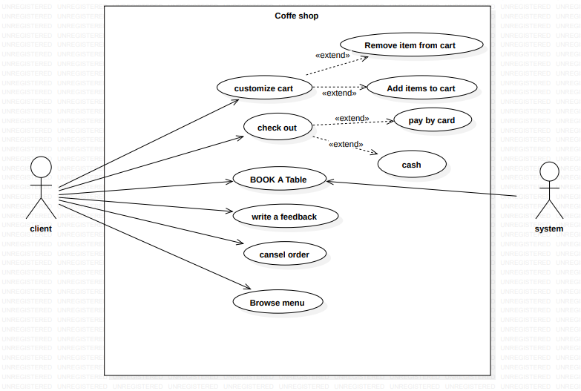

Slide 4
DATA FLOW DIAGRAM

Slide 5
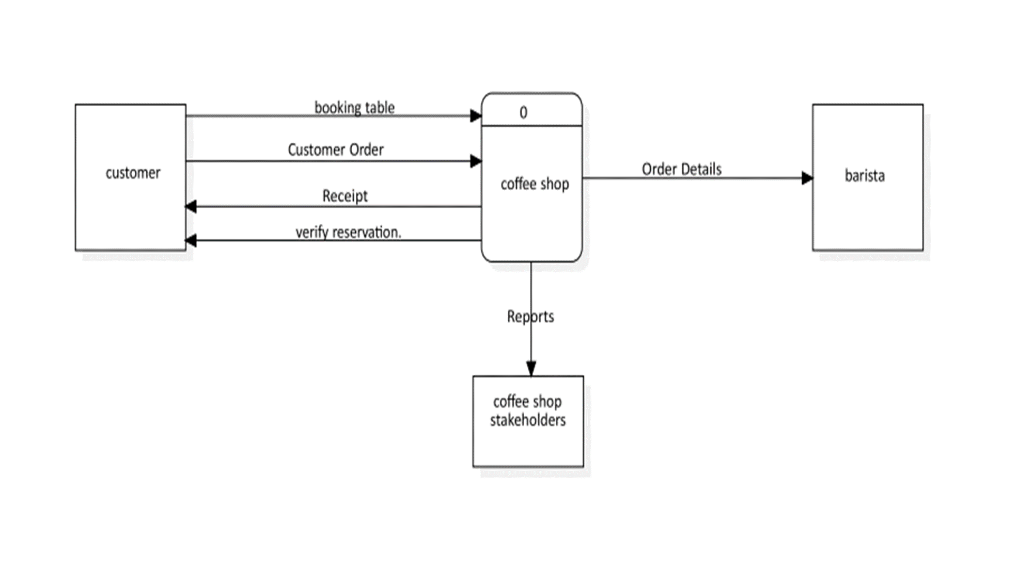
LEVEL 0

Slide 6
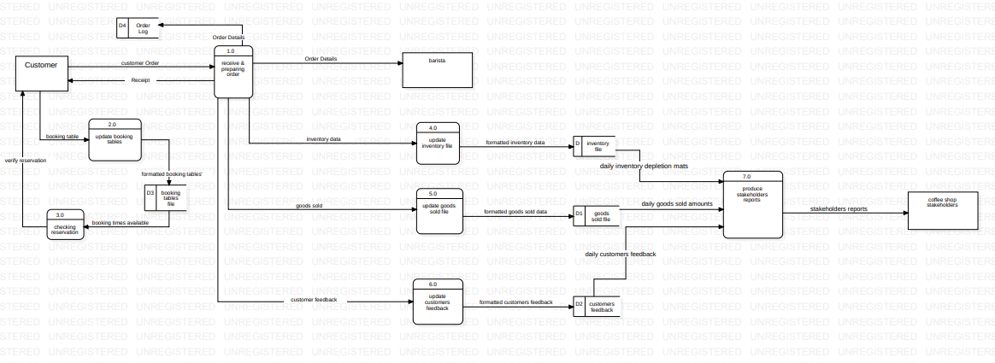
LEVEL 1

Slide 7
DECASION TABLE

Slide 8
The Rules
Normal Customers Get 5$ Coupon
Special Customers who buys with more than 1,000$ or more gets 10% discount, if he pays with credit card, he gets
additional 5% discount
Special Customers who order less than 1000$, take 25 bonus coupon
 | Rules
Condition | 1 | 2 | 3 | 4 | 5 | 6 | 7 | 8
Special Customer | 🗸 | 🗸 | 🗸 | 🗸 | 🗴 | 🗴 | 🗴 | 🗴
Buys1000 or more | 🗸 | 🗸 | 🗴 | 🗴 | 🗸 | 🗸 | 🗴 | 🗴
Pays With Card | 🗸 | 🗴 | 🗸 | 🗴 | 🗸 | 🗴 | 🗸 | 🗴
Action
Receive 5$ Coupon |  |  |  |  | 🗸 | 🗸 | 🗸 | 🗸
Take 10% Discount | 🗸 | 🗸
Take another 5% Discount | 🗸
Take 25$ Coupon |  |  | 🗸 | 🗸

Slide 9
Simplified
Condition | 1 | 2 | 3 | 5
Special Customer | 🗸 | 🗸 | 🗸 | 🗴
Buys 1000$ or more | 🗸 | 🗸 | 🗴 | -
Pays With Card | 🗸 | 🗴 | - | -
Action
Receive 5$ Coupon |  |  |  | 🗸
Take 10% Discount | 🗸 | 🗸
Take another 5% Discount | 🗸
Take 25$ Coupon |  |  | 🗸

Slide 10
THANK YOU

